Slide 1



JOB SEARCH DASHBOARD
MASTERS RESEARCH PROJECT
Professor: Maria Weber
Group: 13
Venkata Rahul Chinta
Srividya Chatakondu
Thanusha Reddy Elluru
Divya Garapati
Sai Nikhil Reddy Kura

Slide 2
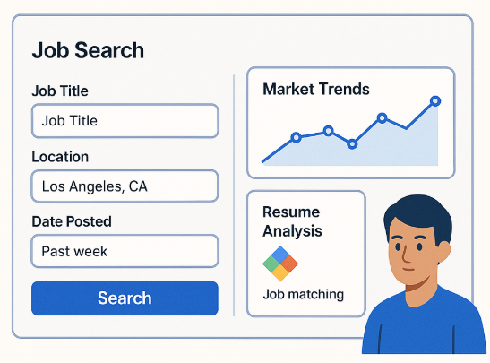
PROJECT OVERVIEW
Objective: Build an AI-powered web application to assist job seekers with job discovery, market analysis, and resume optimization.
Key Features:
Interactive job search with filters
Market trend visualizations
Resume analysis and job matching using Gemini Flash 2.0
Daily job data updates via free API
Deployment: Hosted on Vercel, likely generated with v0
Context: Master’s research project exploring AI-driven job search tools

Slide 3
INTENTED USER PROFILE
User Profile
Role: Entry-level to mid-level job seekers (e.g., recent graduates, career switchers) in technical fields (e.g., software development).
Organizational Hierarchy: Individual contributors, not decision-makers in organizations, seeking employment.
Needs: Identify relevant jobs, understand market trends, optimize resumes for ATS and employer requirements.
Thought Process
Analyzed job market data showing high demand for technical roles (e.g., JavaScript, TypeScript).
Focused on users needing actionable insights to compete in a remote-heavy market.
Aligned with resume analysis feature to support skill-based job matching.
Challenges
Defining a broad yet specific user group.
Ensuring features cater to diverse technical roles.
Solutions
Conducted user persona analysis to focus on technical job seekers.
Incorporated flexible filters (e.g., role dropdown) to broaden applicability.
Relevant Courses:
Applied Analytics and Ethical Evidence-based Decision Making: Informed user profiling through market data insights.

Slide 4
DECISION-MAKING NEEDS OF THE USER
Key Areas of Responsibility
Job Selection: Identifying high-match job opportunities based on skills and preferences.
Career Strategy: Understanding market trends (e.g., skills in demand, remote vs. onsite) to target roles.
Resume Optimization: Enhancing resumes to improve ATS scores and employer appeal.
How the Application Meets Needs
Job Selection: Search filters and job matching provide tailored job listings (e.g., 90% match for Angular Developer).
Career Strategy: Market analysis visualizations highlight trends (e.g., 3 new postings/day, remote dominance).
Resume Optimization: AI suggestions (Gemini Flash 2.0) recommend skills (e.g., add Angular) and ATS improvements.
Decision Process
Mapped user needs to features via user stories (e.g., “As a job seeker, I want to know top skills”).
Validated with sample job data (93 jobs) and resume analysis outputs.
Challenges
Balancing feature complexity with user simplicity.
Limited API data (e.g., $0 salary) affecting trend accuracy.

Slide 5
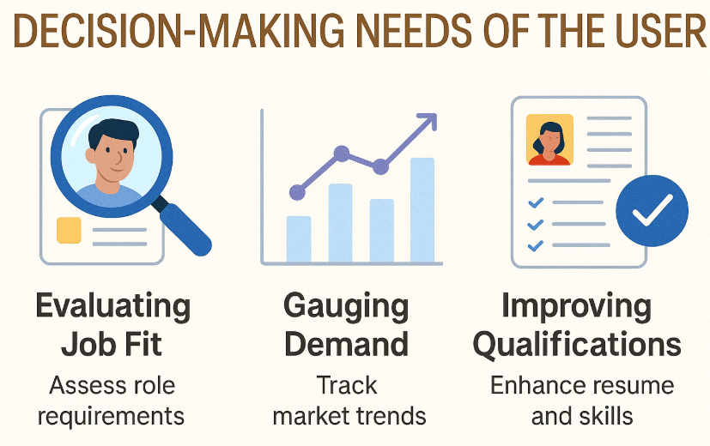
DECISION-MAKING NEEDS OF THE USER (contd)
Solutions
Relevant Courses:
Prioritized intuitive UI (e.g., dropdowns, graphs) for ease of use.
Supplemented API data with AI-generated insights.
Ethical Evidence-based Decision Making: Shaped feature prioritization for decision-making.
Machine Learning Fundamentals: Enabled integration of Gemini Flash 2.0 for AI insights.

Slide 6
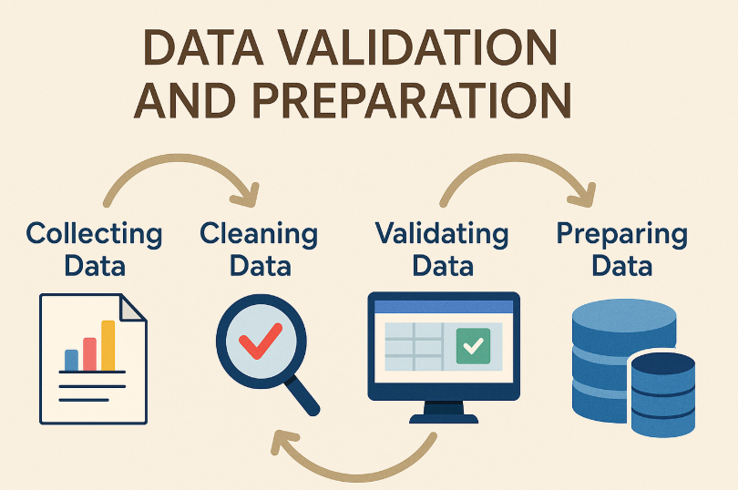
DATA VALIDATION AND PREPARATION
Database Tables and Fields:
Jobs Table:
Fields: job_title, company, location, employment_type, posting_date, skills, salary (optional).
Used for search, matching, and market analysis.
Skills Table:
Fields: skill_name, demand_rank, job_count.
Used for top skills display and resume matching
Resume Table:
Fields: file_name, skills_detected, experiences, ats_score.
Used for resume analysis and job matching.
Identification Process:
Analyzed API response structure to map fields to job data needs
Designed tables to store API data and computed fields (e.g., demand_rank).

Slide 7
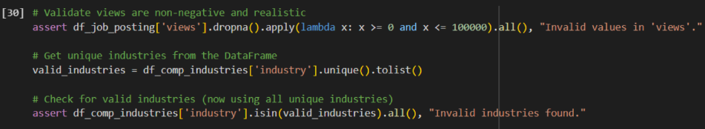
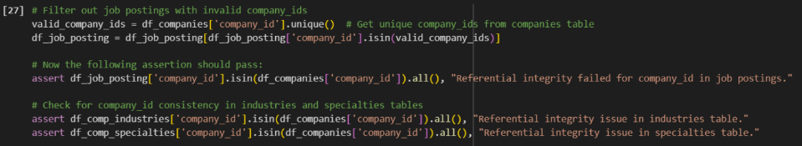
DATA VALIDATION AND PREPARATION (contd)
Validation:
Checked for null/duplicate entries in skills and location.
Verified posting_date recency (within 7 days for “Recent Postings”).
Ensure data accuracy for reliable job matching and trends.
Data Transformation:
Normalized location to standard formats (e.g., “Chicago, Illinois”).
Computed demand_rank by aggregating skill occurrences across jobs.
Generated ats_score using Gemini Flash 2.0’s resume-job alignment algorithm.
Challenges:
Incomplete API data (e.g., missing salaries).
Handling unstructured resume data.
Solutions:
Used fallback values (e.g., $0 salary) and flagged incomplete data.
Leveraged Gemini Flash 2.0 for resume parsing.
Relevant Courses:
Database Management Systems: Guided table design and data validation.
Data Mining: Informed data transformation and ranking algorithms

Slide 8
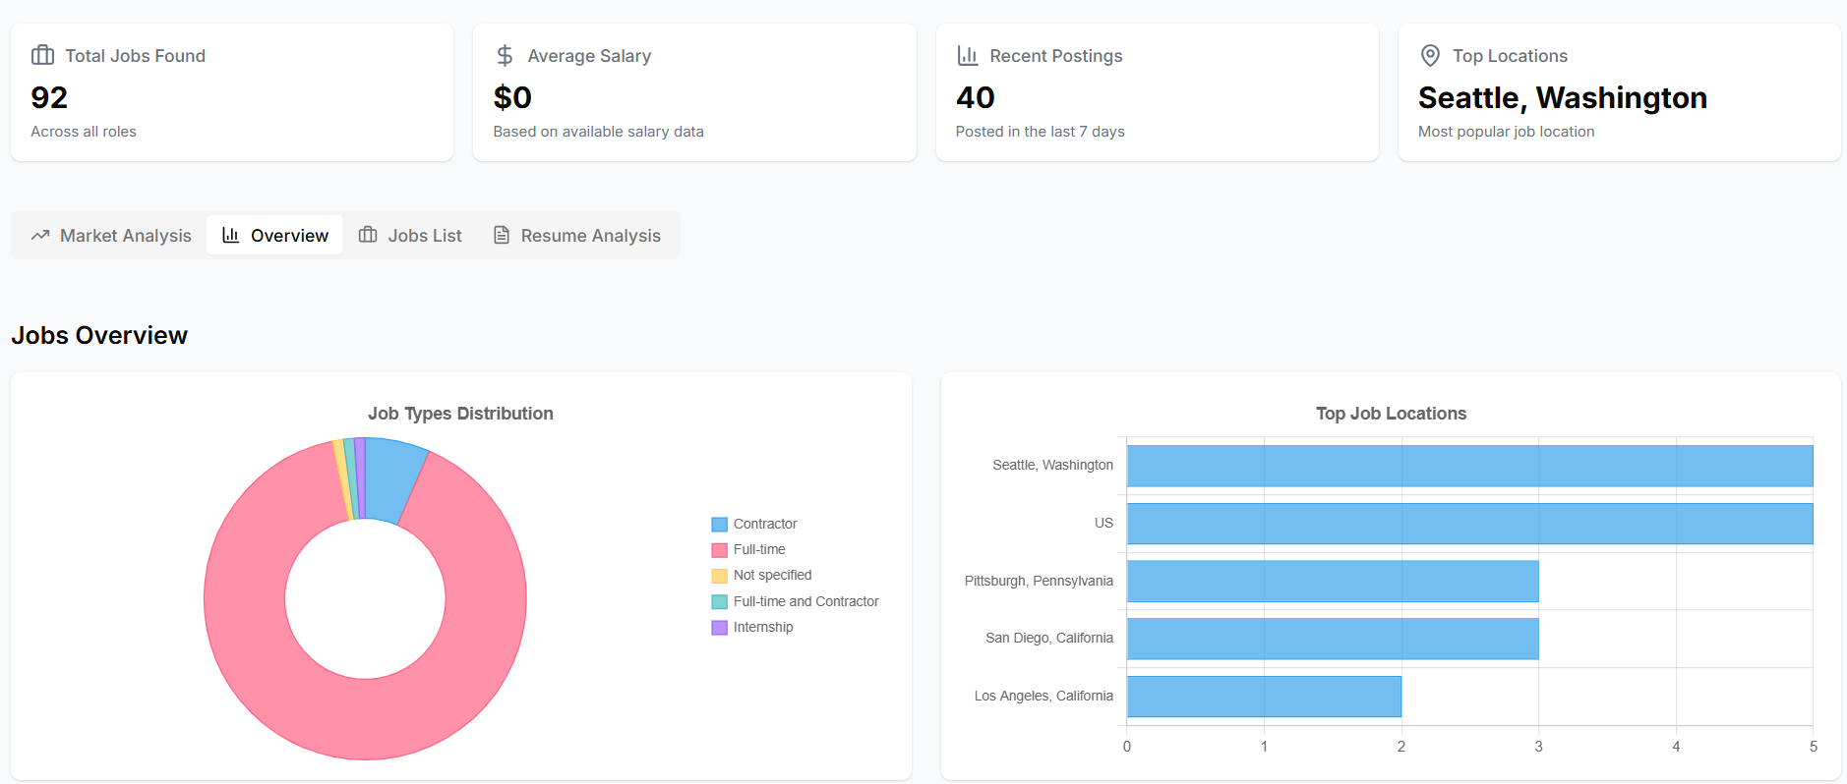
USER INTERFACE DESIGN-OVERVIEW TAB
UI Elements:
Search Query Input: Filters jobs by keyword (e.g., “developer jobs in US”).
Role Dropdown: Narrows jobs by role (e.g., “All Roles”).
Search Jobs Button: Triggers search.
Metrics Cards: Show job count (93), salary ($0), recent postings (40), top location (US).
Market Insights Box: Summarizes trends (e.g., remote work dominance).
Purpose:
Enables quick job discovery and market understanding.
Rationale for Inclusion:
Addresses job selection and career strategy needs.
Metrics provide immediate context; insights guide decisions.
Verification:
User testing confirmed intuitive navigation and data relevance

Slide 9
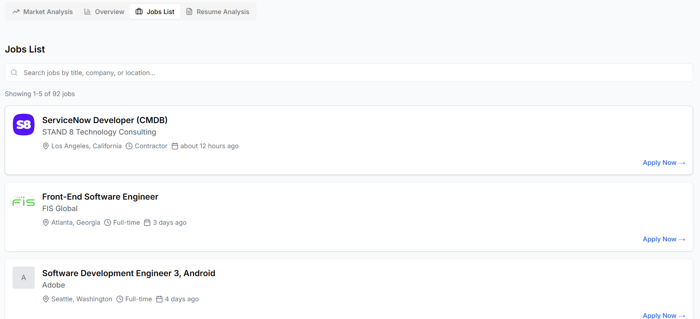
USER INTERFACE DESIGN-JOBS LIST TAB
UI Elements:
Job Cards: Display job title, company, match %, location, posting date, matched keywords.
Apply Now Button: Links to application.
Purpose:
Facilitates job selection by presenting high-match opportunities.
Rationale for Inclusion:
Directly supports job application decisions.
Match % and keywords align with resume skills.
Verification:
Ensured job data accuracy via API validation.

Slide 10
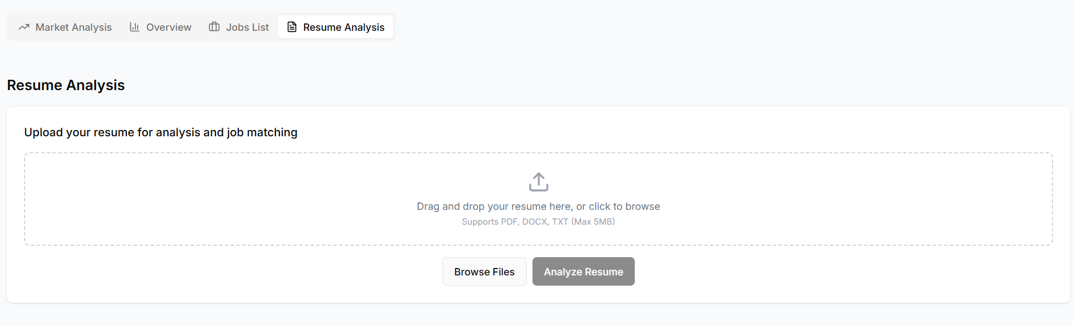
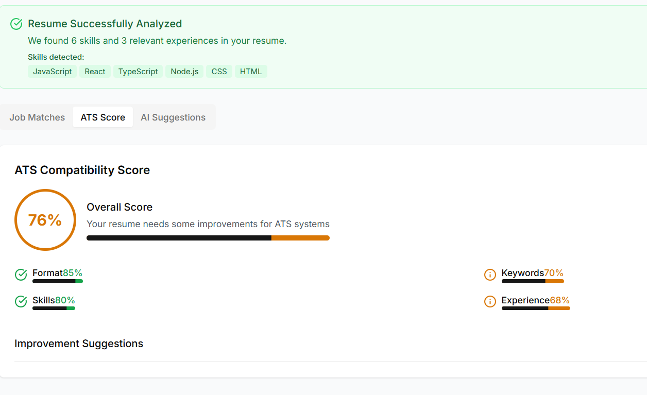
USER INTERFACE DESIGN-RESUME ANALYSIS TAB
UI Elements:
Browse Files Button: Uploads resume (e.g., Person 1’s Resume.pdf”).
Analyze Resume Button: Triggers analysis.
Skills Detected List: Shows extracted skills (e.g., JavaScript, React).
Job Matches Section: Lists top jobs (e.g., Angular Developer, 90% match).
ATS Score Display: Shows resume compatibility.
AI Suggestions Box: Recommends skill additions
Purpose:
Supports resume optimization and job matching.
Rationale for Inclusion:
Addresses resume improvement needs using AI insights.
Verification:
Ensured job data accuracy via API validation.

Slide 11
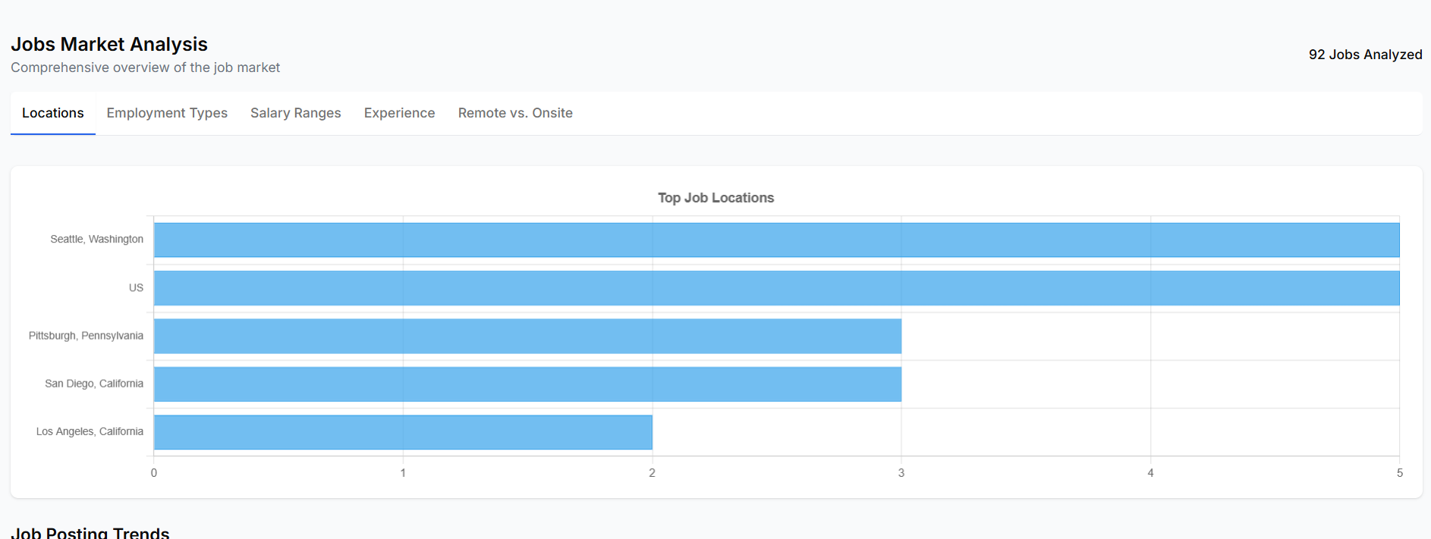
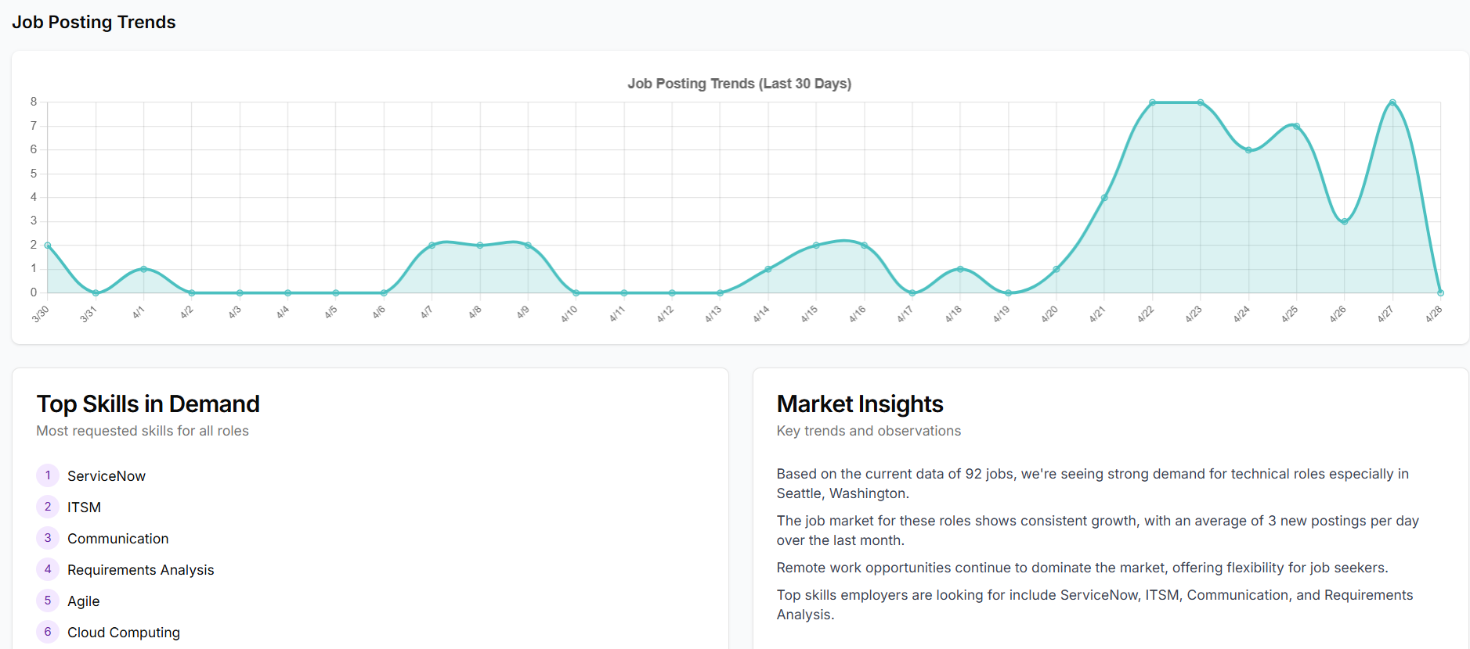
USER INTERFACE DESIGN-JOB MARKET ANALYSIS TAB
UI Elements:
Charts: Bar/pie/line charts for locations, salary ranges, trends.
Top Skills List: Ranked skills (e.g., JavaScript, TypeScript).
Interactive Filters: Allow chart customization (e.g., by location).
Purpose:
Provides deep market insights for career strategy.
Rationale for Inclusion:
Visuals simplify complex data; skills guide learning priorities.
Verification:
Tested chart accuracy against API data.

Slide 12
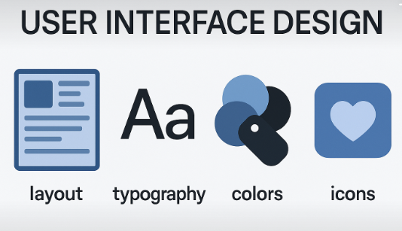
USER INTERFACE DESIGN
Challenges:
Designing responsive, accessible UI.
Integrating Gemini Flash 2.0 for dynamic insights.
Solutions:
Used Tailwind CSS for responsiveness.
Modularized AI integration via Vercel serverless functions.
Relevant Courses:
Web & Mobile Application Development: Informed React/Next.js UI design.
Data Visualization: Guided chart design and interactivity

Slide 13

REFLECTION-PROJECT CHARTER & PROJECT DEFINITION
Lessons Learned:
Defining Charter: Initial scope was broad; refined to focus on technical job seekers via iterative user feedback.
Problem Description: Clarified user needs (job matching, market trends) through data analysis.
Approach:
Used user stories and market data to align features with needs.
Challenges:
Ambiguous user scope.
Solution: Conducted stakeholder analysis inspired by Project Management course.

Slide 14

REFLECTION-TEAM WORK
Team Roles:
Venkata Rahul Chinta: Project Manager, IT Architect
Srividya Chatakondu: Data Analyst, Dashboard Developer
Thanusha Reddy Elluru: Business Process Analyst, IT Architect
Divya Garapati: Data Scientist, Dashboard Develoepr
Sai Nikhil Reddy Kura: Data Analyst, Business Process Analyst
Role Assignment:
Based on skills (e.g., UI expertise, AI knowledge) and interest.
Communication:
Weekly Scrum meetings, Slack for updates.
Challenges:
Coordinating tasks across time zones.
Solution: Used Jira for task tracking, per Software Engineering course.

Slide 15

REFLECTION-ACQUIRING DOMAIN KNOWLEDGE
Approach:
Researched job market trends via online resources (e.g., LinkedIn reports).
Studied Vercel v0 and Gemini Flash 2.0 documentation.
Tools/ Resources:
Vercel docs, Gemini API guides, Stack Overflow.
What worked:
Hands-on prototyping with v0 for UI.
API testing with Postman.
What Didn’t:
Initial reliance on outdated job market blogs; switched to real-time API data.
Relevant Courses:
Information Retrieval: Guided API research.
AI Applications: Informed Gemini integration.

Slide 16

REFLECTION-SELF EFFICACY
Learning New Concepts:
Embraced iterative learning (e.g., mastered Next.js via tutorials).
Working with Others:
Negotiated tasks by aligning strengths; ensured accountability via regular check-ins.
Effort Estimation:
Underestimated API integration time; improved via Software Project Management techniques (e.g., PERT).
Challenges:
Initial overconfidence in AI integration.
Solution: Broke tasks into smaller milestones.

Slide 17
REFLECTION-FUTURE APPLICATIONS
Professional Pursuits:
Apply user-centered design to build intuitive tools.
Use agile methodologies for team projects.
Academic Pursuits:
Leverage data-driven problem definition in research.
Explore AI-driven decision support further.
Key Takeaway:
Iterative refinement and teamwork are critical for complex projects.

Slide 18
CONCLUSION
Summary:
JobSearch Dashboard empowers technical job seekers with job discovery, market insights, and resume optimization.
Built with Vercel, Gemini Flash 2.0, and free API for scalability and AI insights.
Impact:
Addresses real-world job search challenges.
Demonstrates AI and web development synergy.
Future Work:
Enhance API for real-time data.
Expand resume analysis for non-technical roles.

Slide 19


THANK
You

